Slide 1
Adidas Sales Analysis Dashboard
Power BI Dashboard Presentation
BY Anisha M

Slide 2
Problem Statement
Analyze Adidas sales performance
Understand monthly sales trends
Identify best performing regions, products, and retailers
Support business decision making

Slide 3
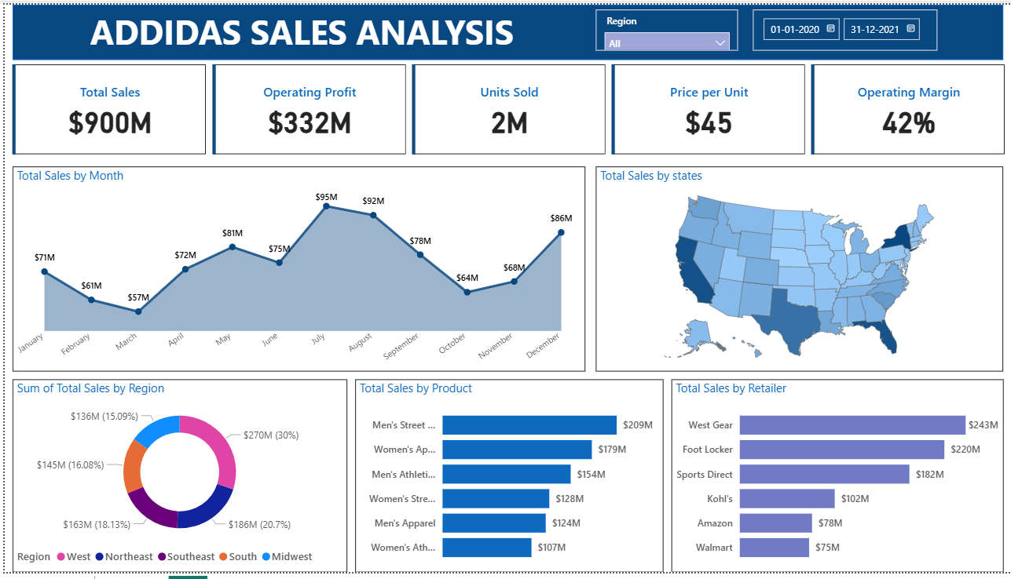
Dashboard overview
.

Slide 4
Key Performance Indicators
Total Sales: $900M
Operating Profit: $332M
Units Sold: 2M
Price per Unit: $45
Operating Margin: 42%

Slide 5
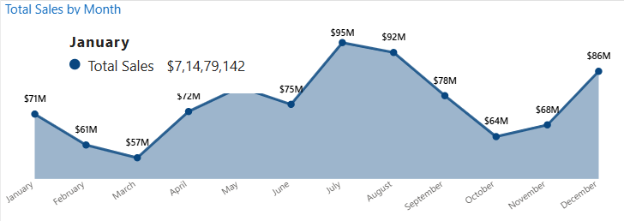
Monthly Sales Insights
Highest sales in July: $95M
Second highest in August: $92M
Lowest sales in March: $57M
Sales increased again in December: $86M

Slide 6
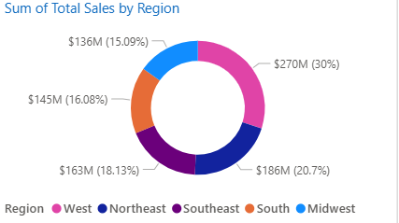
Regional Sales
West: $270M (Highest)
Northeast: $186M
Southeast: $163M
South: $145M
Midwest: $136M (Lowest)

Slide 7
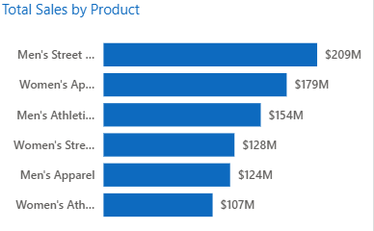
Product Performance
Men's Street Footwear: $209M (Top)
Women's Apparel: $179M
Men's Athletic Footwear: $154M
Women's Street Footwear: $128M
Men's Apparel: $124M
Women's Athletic Footwear: $107M

Slide 8
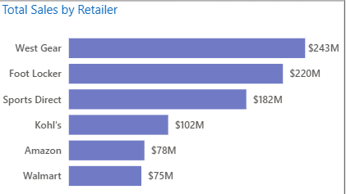
Retailer Performance
West Gear: $243M (Top)
Foot Locker: $220M
Sports Direct: $182M
Kohl's: $102M
Amazon: $78M
Walmart: $75M

Slide 9
Key Insights
West region contributes highest sales
Men's Street Footwear is best product
West Gear is best retailer
Sales peak in mid-year

Slide 10
Recommendations
Focus more on the West region and high-selling products
Improve performance in low-sales regions with targeted strategies
Strengthen partnerships with top retailers
Use seasonal trends for better planning and forecasting

Slide 11
Conclusion
The analysis shows strong Adidas performance with $900M in sales and a 42% operating margin.
Sales peak during mid-year, especially in July and August.
The West region is the highest contributor, Men’s Street Footwear is the top product, and West Gear is the best-performing retailer.
These insights support data-driven business decisions.

